Slide 1
Communicating Climate Change to Industries
This presentation is aimed to sensitize industry organizations in MMR across various facets of climate change. It introduces the science of climate change, gives an overview of the vulnerability and impacts on the MMR and what actions businesses could to overcome the impacts.
The presentation is part of the series Climate Change related Resources and Tools (CCRT).
Conceived and Developed by :
Environmental Management Centre LLP for Mumbai Metropolitan Region – Environment Improvement Society

Slide 2
Communicating climate change to Industries
Prepared by: Environmental Management Centre _{LLP}

Slide 3
Global Warming
What are greenhouse gases?
Gases that contribute to the greenhouse effect by absorbing infrared radiation, e.g. carbon dioxide, Methane, Nitrous oxide
How are they generated?
By travelling
By using electricity
By running industries
Earth requires greenhouse gases so that living beings can survive
We add more greenhouse gases every day
BUT
Sunlight
Reflected sunlight
Radiated back to space
Leading to
SO
Absorption by land and water
Heat trapped by greenhouse gases
More heat is trapped
GLOBAL WARMING
Notes:
The atmosphere has a natural supply of "greenhouse gases." They capture heat and keep the surface of the Earth warm enough for us to live on. Without the greenhouse effect, the planet would be an uninhabitable, frozen wasteland.
Before the Industrial Revolution, the amount of carbon dioxide (CO₂) and other greenhouse gases released into the atmosphere was in a rough balance with what was absorbed in natural sinks. For example, plants take in CO₂ when they grow in spring and summer, and release it back to the atmosphere when they decay and die in fall and winter.
Industry took off in the mid-1700s, and people started emitting large amounts of greenhouse gases. Fossil fuels were burned more and more to run our cars, trucks, factories, planes and power plants, adding to the natural supply of greenhouse gases. The gases—which can stay in the atmosphere for centuries—are building up in the Earth’s atmosphere and, in effect, creating an extra-thick heat blanket around the Earth.
The result is that the globe has heated up by about one degree Fahrenheit over the past century—and it has heated up more intensely over the past two decades.
Today, people have increased by nearly 40 percent the amount of CO₂, the chief global warming pollutant, compared to pre-industrial levels

Slide 4
Effects of global warming
Impacts on Mumbai
Change in Living conditions of plants and animals
Habitat loss and extinction
Change in Living conditions of plants and animals
Habitat loss and extinction
Change in Seasons
Change in migration patterns
Droughts and wild fires in some places
Change in migration patterns
Increased evaporation
Global warming
Melting of glaciers,
snow caps
Increased Rains in some places
Increased absorption of energy by Earth
Increased Rains in some places
Warmer Oceans
Increased storms
Sea Level Rise
Increased storms
Sea Level Rise
Adapted from: http://epa.gov/climatechange/kids/basics/concepts.html
Notes:
Rising global temperatures lead to other changes , such as stronger hurricanes, melting glaciers, and the loss of wildlife habitats. That's because the Earth's air, water, and land are all related to one another and to the climate. This means a change in one place can lead to other changes somewhere else. For example, when air temperatures rise, the oceans absorb more heat from the atmosphere and become warmer. Warmer oceans, in turn, can cause stronger storms.
Since the 1970s, droughts have become longer and more extreme worldwide, particularly in the tropics and subtropics.
As temperatures rise and the air becomes warmer, more moisture evaporates from land and water into the atmosphere. More moisture in the air generally means we can expect more rain and snow (called precipitation) and more heavy downpours. But this extra precipitation is not spread evenly around the globe, and some places might actually get less precipitation than they used to get. That's because climate change causes shifts in air and ocean currents, which can change weather patterns
Hurricanes and other tropical storms get their energy from warm ocean water. As the top layer of the ocean gets warmer, hurricanes and other tropical storms grow stronger, with faster winds and heavier rain. Because of higher temperatures and increased evaporation, climate change causes other types of storms to get stronger, too.
As water gets warmer, it takes up more space. Each drop of water only expands by a little bit, but when you multiply this expansion over the entire depth of the ocean, it all adds up and causes sea level to rise. Sea level is also rising because melting glaciers and ice sheets are adding more water to the oceans.

Slide 5
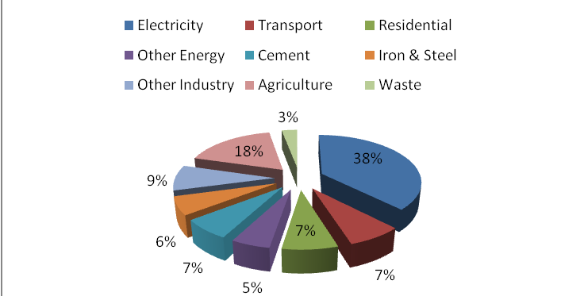
GHG emissions
Major Polluting Industries in MMR
GHG Emissions by sector - India
Thermal power plants
Cement
Iron and steel
Food processing
Chemical (Ammonia & ethylene production)
Aluminium
Total industrial emissions – 22%
Ferro alloys
Textile & Tanneries
Pulp & Paper
Source: INCCA (2010), India: greenhouse gas emissions 2007, Ministry of Environment and Forests, GOI, New Delhi
Notes:
Industrial sector is a major contributor to the emissions. This slide gives the share of industries and the type of industries which are major emitters in MMR

Slide 6
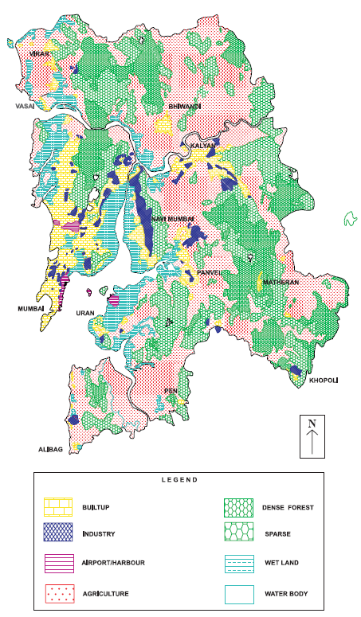
Industries in MMR
Wagle, Thane
Mira-Bhayandar
Badlapur
Ambernath
Navi Mumbai
Pen-Alibaug
Khopoli
Rasayani
South Mumbai
Dharavi
Bhiwandi
Dombivili
Marol
Chemicals
Textiles
Pharmacy
IT
Electronics
Electronic and electrical products
Engineering Products
Food products
Chemicals
Metal products
Pharmacy
Textiles
Chemicals
Plastic products
Leather
Textiles
Food products
Chemicals
Engineering
Pharmacy
Chemicals
Pharmacy
Metal products
IT, Software, BPOs
Petrochemicals
Textiles
Food products
Petrochemicals
Steel products
Textiles
Chemicals
Metal products
Engineering
Beverages
Chemicals
Petrochemicals
Textiles
Automobiles, ancillary
Pharmacy
IT
Food products
Paper, paper products
Waste recycling
Pottery
Leather tanneries
Embroidery
Paper mills
Pharmacy
Chemicals
Warehousing
Textiles
No. of industrial Units in MMR - 7850
Source: MMRDA(1999) Regional Plan for Mumbai Metropolitan Region 1996-2011, Ch.2 ‘Regional setting', Maharashtra Government Gazette, Mumbai
Notes:
This slide gives information about the location of different types of industries in MMR region along with other land use.

Slide 7
Industrial zones
Maximum no. of industries are small scale
Source: MMRDA(1999) Regional Plan for Mumbai Metropolitan Region 1996-2011, Ch.2 ‘Regional setting', Maharashtra Government Gazette, Mumbai
Notes:
This slide gives an information on what are the industrial zones in MMR, the type of industries present and their scale.

Slide 8
Reduction of GHG emissions
ACTIONS
Fuel switch
Switching to less carbon-intensive industrial fuels such as natural gas
The efficient use of biomass in steam and gas turbine
(E.g. Pulp and paper, forest products and some agricultural industries such as sugar cane)
New technologies
Use of new efficient technologies and mechanisms to reduce fuel use and time consumed to produce 1 unit of product
Cogeneration
The production of electricity using waste heat (as in steam) from an industrial process or the use of steam from electric power generation as a source of heat
E.g. coal-intensive industry has the potential to reduce its CO₂ emissions by half, without switching fuels, through cogeneration.
Process improvements
Industrial process alterations can reduce all process-related GHGs significantly or even eliminate them entirely.
Replacing natural gas as the source of industrial hydrogen with biomass hydrogen or with water electrolysis using carbon-free energy sources reduces carbon emissions in the manufacture of ammonia and replace coking coal in the production of iron
Replacing materials associated with high GHG emissions with alternatives that perform the same function
e.g., the fly-ash substitution and the use of waste fuels
Material substitution
The recycling and reuse of goods can save not only energy but GHGs released to the atmosphere
Primary materials release about four times the CO2 of secondary (recycled) materials in steel, copper, glass and paper production
Material recycling
Source: IPCC (1996), Technologies, Policies and Measures for Mitigating Climate Change, Pg 34-35
Notes:
This slide gives information on what kinds of actions and measures can be taken so as to reduce the GHG emissions by industries.

Slide 9
Means to reduce GHG
CHEMICALS
PETROLEUM REFINING
PULP AND PAPER
FOOD
IRON AND STEEL
CEMENT
Technologies
Actions
Energy efficiency
Smelt reduction, Near net shape casting, Scrap preheating, Dry coke quenching
Membrane separations, Reactive distillation
Membrane separation Refinery gas
Precalciner kiln, Roller mill fluidized bed kiln
Efficient pulping, Efficient drying, Shoe press, Condebelt drying
Efficient drying, Membranes
Natural gas, oil or plastic injection into the Boiler Fuel
Natural gas
Natural gas
Waste fuels, Biogas, Biomass
Biomass, Landfill gas
Fuel Switching
Biogas, Natural gas
Top-gas pressure recovery, Byproduct gas combined cycle
Pre-coupled gas turbine, Pressure recovery turbine, H₂recovery
Pressure recovery turbine, hydrogen recovery
Drying with gas turbine, power recovery
Black liquor gasification combined cycle
Power Recovery
Anaerobic digestion, Gasification
Biomass, Biogas, Solar drying
-
-
Bio-fuels
Renewables
Biomass fuels, Biogas
Biomass fuels (bark, black Liquor)
Scrap
Recycled plastics, biofeedstock
Biofeedstock
Slags, pozzolanes
Recycling, Non-wood fibers
Feedstock change
-
High Strength steel
Linear low density polyethylene, high performance Plastics
-
Blended cement Geo-polymers
Fibre orientation, Thinner paper
Product change
-
Recycling, High strength steel, Reduction process losses
Recycling, Thinner film and coating, Reduced process losses
Increased efficiency transport sector
-
Reduction cutting and process losses
Material efficiency
Reduction process losses, Closed water use
Hydrogen reduction, Oxygen use in blast furnaces
Application to ammonia, ethylene oxide processes
From hydrogen production
O₂ combustion in kiln
O₂ combustion in kiln
CO₂ sequestration
-
Source: Bernstein, L., J. Roy, K. C. Delhotal, J. Harnisch, R. Matsuhashi, L. Price, K. Tanaka, E. Worrell, F. Yamba, Z. Fengqi, 2007: Industry. In Climate Change 2007: Mitigation. Contribution of Working Group III to the Fourth Assessment Report of the Intergovernmental Panel on Climate Change, B. Metz, O.R. Davidson, P.R. Bosch, R. Dave, L.A. Meyer (eds)], Cambridge University Press, Cambridge, United Kingdom and NY, USA.
Notes:
The means to reduce emissions by use of different technologies specific to the sector.

Slide 10
Case studies

Slide 11
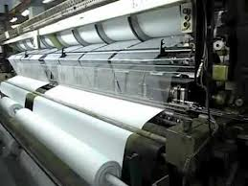
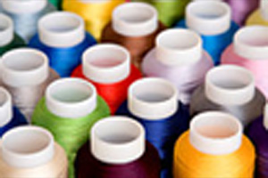
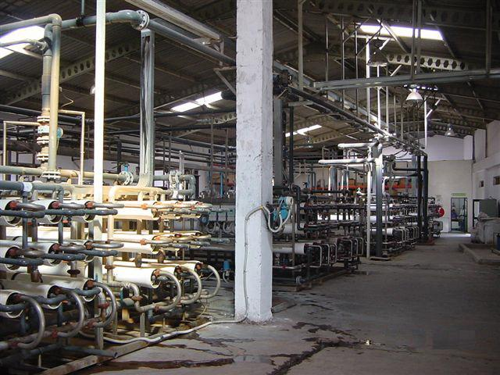
Fuel Switch
Fuel switch
New technologies
Cogeneration and thermal cascading
Process
Improvements
Material
substitution
Material recycling/reuse
Alok Industries Limited (ALOK), Gujarat
Continuous processing textile unit , requires energy in the form of steam and power.
Present: Furnace Oil (FO) based cogeneration plant at the plant site, existing boiler capacity is 36TPH, generates steam at a pressure 45kg/cm² and temperature 440°C
Change: switched from current FO combustion to Natural Gas (NG) combustion
CDM crediting period – 10 years
GHG reduction – 14,240 CO₂e annually. Total - 142,400 t CO₂.
Source: : SGS quality Network, Accessed from: http://www.sgsqualitynetwork.com/tradeassurance/ccp/projects/505/SSCPDD_ALOK_FS_LCD_120508.pdf
Notes:
The project activity entails displacing use of furnace oil with natural gas in energy generation at the Vapi
unit of Alok Industries Limited (ALOK) in Gujarat. Natural Gas (NG) is a cleaner fuel as compared to FO
and displacement of use of Furnace Oil (FO) for NG will result in reduced GHG emissions in energy
generation.
ALOK has a continuous processing textile unit at Vapi in Valsad district and it requires energy in the
form of steam and power. In the pre-project scenario, ALOK generate steam and power in a Furnace Oil
(FO) based cogeneration plant at the plant site. The existing boiler capacity is 36TPH and it generates
steam at a pressure 45kg/sq.cm and temperature 440°C. In the project activity ALOK has switched from
current FO combustion to NG combustion. NG (IPCC default carbon emission factor 15.3 kg C/ GJ) is a
cleaner fuel compared to FO (IPCC default carbon emission factor 21.1 kg C/ GJ) and so the fuel switch
would result in reduced emissions. Total volume of emission reductions estimated over the chosen
crediting period is 142,400 t CO2.
The existing FO fired boiler has been retrofitted to accommodate combustion of NG.
Link:
http://www.sgsqualitynetwork.com/tradeassurance/ccp/projects/505/SSCPDD_ALOK_FS_LCD_120508.pdf

Slide 12
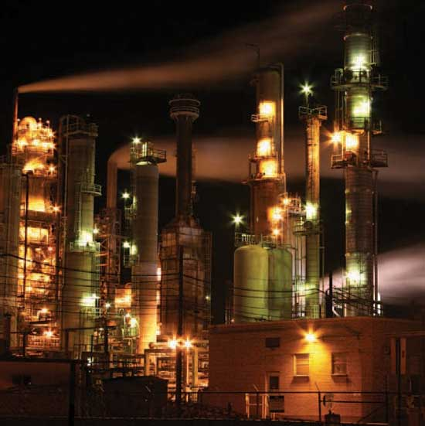
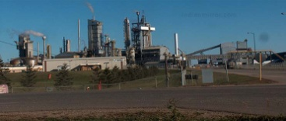
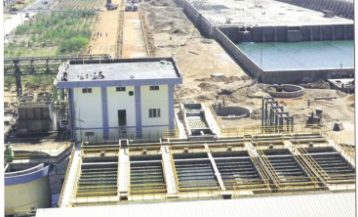
New Technology
Fuel switch
New technologies
Cogeneration and thermal cascading
Process
Improvements
Material
substitution
Material recycling/reuse
Indo Gulf Fertilizers (IGF), Jagdishpur.
The power requirement - Gas Turbine Generators (GTG) of 18MW capacity each, additional by Uttar Pradesh State Electricity Board (UPSEB) grid
Improvements
Heat rate reducing is achieved by cooling the inlet air/ suction air of inbuilt air compressor of the GTG by Mee fogging system.
Upgrading of GTG by carrying out various other energy efficiency measures like replacement of new fuel firing and combustion system, new heat path design, replacement of inlet guide vane etc.
Energy savings
Annual aggregate energy saving of 66.65 GWh_{th}
Environmental benefits
Annual GHG emission reduction: 13511 tons CO₂
Source: SGS quality Network. Accessed from: http://www.sgsqualitynetwork.com/tradeassurance/ccp/projects/466/PDD-GTG.PDF/
Notes:
This is and example of reduced ghg emissions by using a new technology.
The power requirement of the IGF fertilizer complex is currently met by two Gas Turbine
Generators (GTG) of 18MW capacity each, and additional requirement is catered by Uttar Pradesh
State Electricity Board (UPSEB) grid.
The proposed project activity aims to reduce the heat rate by carrying out retrofit measure in one of
the existing GTG, which would lead to reduce the heat rate of the GTG and subsequently reduce
the NG consumption in GTG. The project activity would lead to reduce the over all energy
requirement of IGF Urea complex and reduces the overall GHG emission.
The reduction in heat rate of GTG is achieved by increasing the work done by the compressor of
GTG and implementation of other energy efficiency measure in phase manner. In first phase heat
rate reducing is achieved by cooling the inlet air/ suction air of inbuilt air compressor of the GTG
by mee fogging system. Second phase of the project activity includes the up rating of GTG by
carrying out various other energy efficiency measures like replacement of new fuel firing and
combustion system, new heat path design, replacement of inlet guide vane etc.
CDM credit period: 10 years

Slide 13
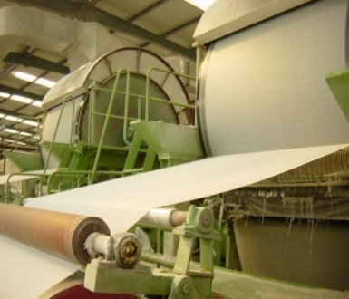
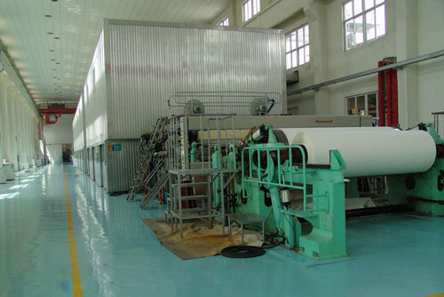
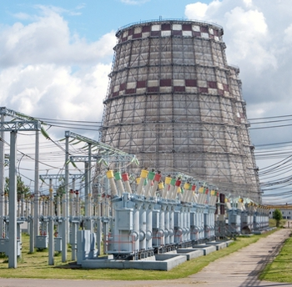
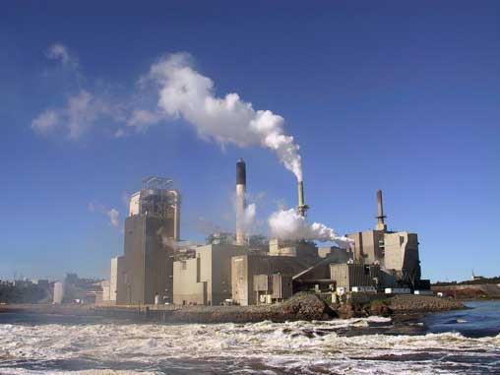
Cogeneration
Fuel switch
New technologies
Cogeneration
Process
Improvements
Material
substitution
Material recycling/reuse
Malu Paper Mills Limited, Nagpur
MPML is setting up a new paper plant with capacity of 150 TPD
Total Capacity - 235 TPD
Cogeneration unit with a multi fuel boiler to facilitate usage of rice husk and other agricultural waste available as a primary fuel.
Reused steam from the production process will generate electricity by the generator
Rated power capacity of project activity is 6MW.
Total thermal capacity of boiler is ~29MWthermal
Environmental benefits
Annual GHG emission reduction: 73,582 metric tons
Source: SGS quality Network. Accessed from: http://cdm.unfccc.int/Projects/DB/SGS-UKL1200594876.36/view
Notes:
The purpose of project activity is to utilize available surplus renewable biomass in the region to generate
steam and electricity at an upcoming plant for making news print paper. Malu Paper Mills Limited
(MPML) is a public limited company. The power shortage situation in the region has been the driving
force for management to consider captive power unit and achieve self reliance for energy needs.
The MPML is setting up a new paper plant with capacity of 150 TPD, which shall enhance the total
capacity of newsprint & Kraft paper making to about 235 TPD.
MPML decided to set up a captive cogeneration unit to meet in-house power and steam demands. The
proponent is actively involved in coal and lignite trading, so procurement of coal is a business as usual
scenario. But taking a lead in the region, MPML decided to set up co generation unit with a multi fuel
boiler to facilitate usage of rice husk and other agricultural waste available as a primary fuel. Due to
various constraints involved in biomass based power generation facility, MPML decided to take up
project activity after considering carbon credit benefits extended for green energy projects through CDM
by UNFCCC. The co-generation unit is expected to be commissioned by Jan 2008 (planned for May 2007
earlier) and subsequently the paper mill shall be commissioned by Feb 2008 (earlier planned for
July2007).
The project comprises of high pressure boiler and a turbine, generator arrangement with maximum output
capacity of 6.0MW. The project activity shall consist of rice husk and other agricultural waste usage as a
primary fuel, and some amounts of coal during start ups. The coal usage shall be to the least possible
quantities and well accounted for. The coal usage shall be continuously monitored and considered as
project emissions.

Slide 14
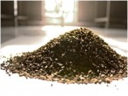
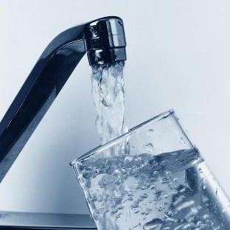
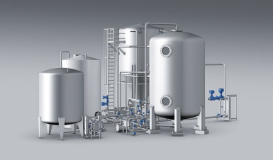
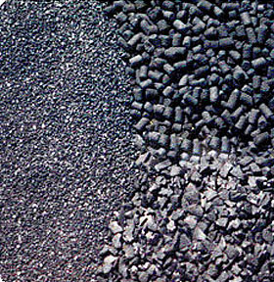
Process improvements
Fuel switch
New technologies
Cogeneration and thermal cascading
Process
Improvements
Material
substitution
Material recycling/reuse
Active carbon India ltd, Hyderabad
Production – 1500 tons/year granular activated carbon
Prepared from coconut shell charcoal by using steam activation technique
The air required for the combustion – 700kg/hr, temperature – 30⁰C
Steam generation = 900-950 kg/hr, Excess steam = 200-250 Kg /hr
Kiln preheated from 30 ⁰C to 120 ⁰C by using a part of excess vented steam
Result: Reduction in consumption of fuel oil
Financial benefits:
Investment: US$ 2200 (Rs.94,600)
Annual cost savings: US$ 6715
Payback period: 4 months
Environmental benefits:
Annual GHG reduction: 49.5 tons CO2
Source: UNEP (2006), Greenhouse Gas Emission Reduction from Industry in Asia and the Pacific, New Delhi. Accessed from: http://www.energyefficiencyasia.org/
Notes:
Active Carbon India Pvt. Ltd., with a plant capacity of 1500 tons/year, is a leading manufacturer
of granular activated carbon prepared from coconut shell charcoal. The plant operates two rotary
oil fired kilns in parallel. The kiln represents the heart of the process wherein raw carbon (roasted
coconut shells) is activated by steam to form granular activated carbon. Based on the discussions
and feedback, the Team identified ‘combustion of furnace oil in the kiln’ as one of the key focus
areas, wherein it was perceived that there existed a significant margin for improvement (in
combustion efficiency) and thereby reduction in furnace oil consumption and consequent GHG
reduction.
Furnace oil is burnt to produce heat in the kiln and in an ambience of low oxygen the granular
coconut shells undergo devolatilisation and with simultaneous injection of steam, the coke gets
activated. The option, of ‘Preheating the combustion air to the kiln’, was evolved based on the
following observations.
The air required for the combustion of furnace oil was supplied at ambient condition of 30 0C.
An excess of 250 kg/hr of steam (generated from waste exhaust hot gas of kiln) was available
after a modification involving interconnection of flue gas paths of both of kiln # 1 and 2, to
maximize waste heat recovery potential

Slide 15
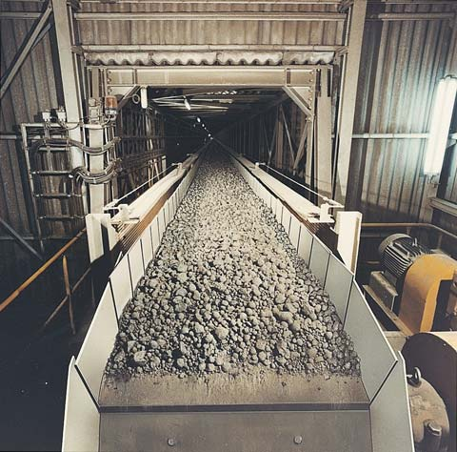
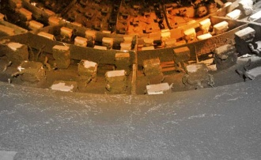
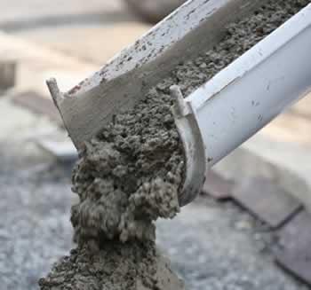
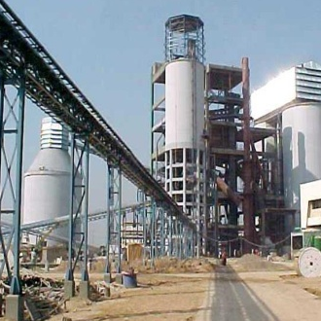
Material substitution
Fuel switch
New technologies
Cogeneration and thermal cascading
Process
Improvements
Material
substitution
Material recycling/reuse
Material
recycling
OCL India Limited, Orissa
Dry process based cement plant with installed capacity of 1.01 million tones
Clinker is an intermediate product during manufacturing of cement which is produced by a GHG-emission-intensive process called clinkerisation
Present slag additive percentage in PSC: in the range of 42 - 45%
Reduction of clinker content by adding 57% slag additive(PSC)
Financial benefits:
Material cost savings, reduces the quantum of limestone required per unit of cement produced
Environmental benefits:
Average GHG emissions eliminated: 42346 tons/year
Source: UNFCCC(2004), CDM:PDD, OCL Ltd., Accessed From: http://cdm.unfccc.int/filestorage/D/Y/Y/DYYYLHS8H4Y6G49MMBRJD5HXJBY6BZ/OCL_PSC_PDD050806_rev03_final.pdf?t=QmZ8bWV0YWpnfDB-k8I70zCzRQuCZEy2FIcf
Notes:
The project proponent, OCL India Limited (formerly Orissa Cement Limited) established its operations in
the year 1951 and currently manufactures cement, refractory and sponge iron. OCL India Limited
(referred to as OCL in the rest of the document) owns a fully integrated modern dry process based cement
plant with installed capacity of 1.01 million tones located at Rajgangpur in state of Orissa in eastern
India. The company also owns limestone, fireclay and Kaolin mines in the areas adjoining the plant.
In the manufacturing of various types of cement, clinker is an intermediate product which is produced by
a GHG-emission-intensive process called clinkerisation. The project activity aims at reducing clinker
content in the production of Portland Slag Cement (PSC) by increasing slag additive percentage (%) thus
leading to GHG emissions reductions per tonne of the cement manufactured
Separately ground clinker - gypsum mixture and granulated slag are mixed to obtain PSC at OCL. Clinker
is produced by dry process in the plant premises itself. The clinker production involves highly energy
intensive processes such as mining of limestone and its transportation, pre-processing (grinding) and
pyro-processing (calcination) of raw meal that consists of limestone, clay, minerals and sandstone. The
major source of CO2 emissions in clinker production is the pyro-processing stage where lime is calcined
by burning coal in the kiln and the precalciner. The other source of CO2 emissions is the fossil fuel
combustion for the electrical energy generation, required in the clinkerisation process [pre-processing and
pyro-processing].
Therefore, by increasing slag and proportionately reducing clinker percentage in the manufacturing of
PSC, there will be a direct reduction of fossil fuel (coal), raw material (limestone) and electrical energy
consumption in the clinkerisation process.
In the pre-project scenario OCL’s slag additive percentage in PSC was in the range of 42 - 45%. The
company proposes to achieve 57 % slag additive in PSC from 2006-07 onwards.

Slide 16
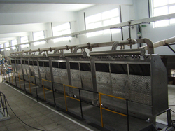
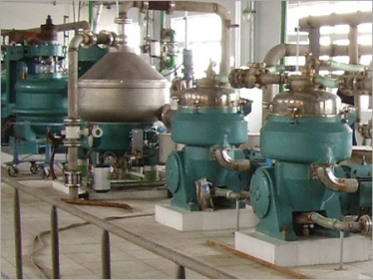
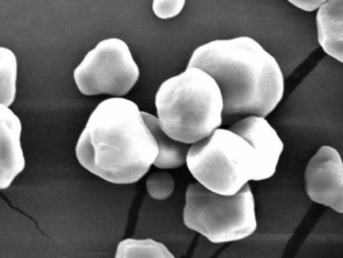
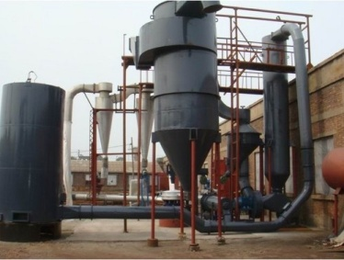
Material reuse
Fuel switch
New technologies
Cogeneration and thermal cascading
Process
Improvements
Material
substitution
Material recycling/reuse
Riddhi Siddhi Gluco Biols Ltd.
Producer of high quality starch, glucose and their derivatives from corn.
1500 - 1600 cu.m /day of wastewater is generated from the operations with COD – 25 kg/cu.m, BOD – 15kg/cu.m
Anaerobic treatment for methane recovery by Hydrolysis, Acidogenesis and Methanogenesis.
Two gas engines each of 0.985 MW are installed to consume the biogas and to produce electricity.
After aerobic treatment dried sludge is produced which is used for soil conditioning
Environmental benefits :
Average GHG emissions eliminated: 44,201 tons/year
Odour reduction due to closed anaerobic treatment.
Source: DNV (2006), CDM: PDD, Riddhi Siddhi Gluco Biols Ltd, Accessed from: http://www.dnv.com/focus/climate_change/upload/pdd_riddhi%20siddhi_ver01%20_2_.pdf
Notes:
Riddhi Siddhi Gluco Biols Ltd. (RSGBL) is a manufacturer of high quality starch, glucose and their
derivatives. RSGBL produces Maize starch powder and its derivatives such as Liquid glucose, Dextrose
Monohydrate, Maltodextrine, Dextrose syrup, High maltose corn syrup and the by products like Maize
Germ, Corn Gluten meal, Corn Steep Liquor, Enriched Fibre, Cattle feed and Hydrol which are used in
various applications catering to food, textile, paper, pharmaceutical and confectionary industries. The
industry crushes about 750 tones of corn per day.
The maize/ corn is the basic raw material of the industry. The cleaned corn is steeped in sulphurous acid
water for about 50 hours. Light steep water is generated while steeping which is concentrated up to 50 %
to get corn steep concentrate also known as Corn Steep Liquor (CSL). The steeped corn is passed
through degerminating mills to separate out Germs. The remaining material is again passed through
various grinding and separation stages to separate out gluten from starch. Gluten slurry is thickened by
centrifugation and vacuum filtration before drying. The starch slurry further processed in hydrocyclones
to remove trace amount of impurities. This slurry is called wet starch from which, the final products of
Starches, Liquid glucose, Dextrose monohydrate and Maltodextrines are produced.
Considerable quantity of wastewater is generated from steeping, dewatering and refining processes and
this wastewater is rich in organics. This organic rich wastewater was treated through open anaerobic
lagoons to reduce its organic concentrations before discharge to meet the environmental norms. Methane,
a potent Green House Gas (GHG), rich biogas was formed and emitted to the atmosphere. Realizing the
global warming effects of the biogas on the environment, the project proponents proposed to substitute
these anaerobic lagoons with closed anaerobic reactors to recover methane rich biogas and to utilize this
biogas to generate electricity. Installation of closed anaerobic digesters to recover methane rich biogas
and utilize the biogas to generate electricity is the small scale project activity.

Slide 17
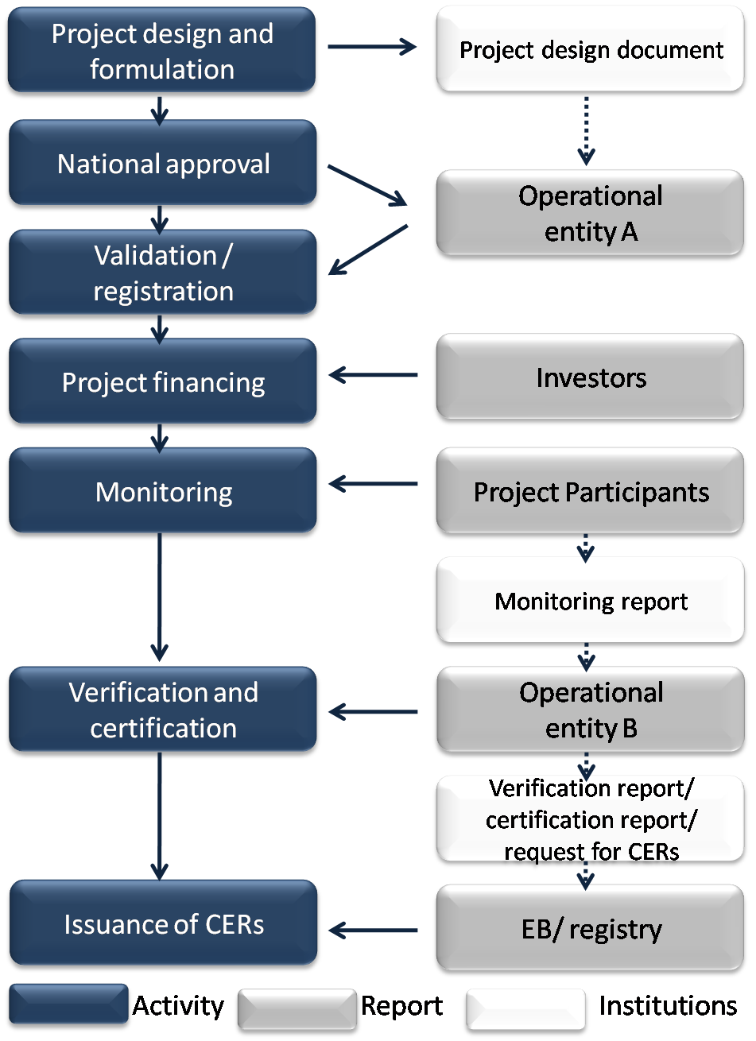
Mechanisms to reduce GHG emissions
Process
Clean Development Mechanism (CDM)
Allows emission reduction projects in developing countries to earn certified emission reduction (CER) credits, each equivalent to one ton of CO2
These CERs can be sold to and used by industrialized countries to meet a part of their emission reduction targets under the Kyoto Protocol.
Source: Shrestha R, (2008),Clean development mechanism: An overview, AIT, Thailand, Pg 114
Notes:
The Clean Development Mechanism (CDM), defined in Article 12 of the Protocol, allows a country with an emission-reduction or emission-limitation commitment under the Kyoto Protocol (Annex B Party) to implement an emission-reduction project in developing countries. Such projects can earn saleable certified emission reduction (CER) credits, each equivalent to one tonne of CO2, which can be counted towards meeting Kyoto targets.
A CDM project activity might involve, for example, a rural electrification project using solar panels or the installation of more energy-efficient boilers.
For further information : http://cdm.unfccc.int/stakeholder/workshops/poa/cdm_project_cycle.pdf

Slide 18
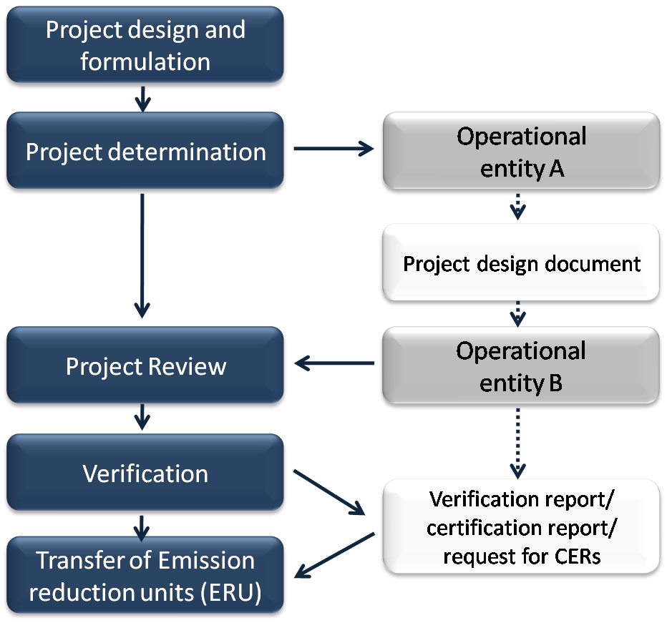
Continued…
Process
Joint Implementation (JI)
Allows a country with an emission reduction or limitation commitment under the Kyoto Protocol (Annex B Party) to earn emission reduction units (ERUs) from an emission-reduction or emission removal project in another Annex B Party
Flexible and cost-efficient means of fulfilling a part of their Kyoto commitments, while the host Party benefits from foreign investment and technology transfer.
Source: http://unfccc.int/kyoto_protocol/mechanisms/joint_implementation/items/1674.php
Fig.http://www.jonmqueen.org/
Notes:
he mechanism known as “joint implementation,” defined in Article 6 of the Kyoto Protocol, allows a country with an emission reduction or limitation commitment under the Kyoto Protocol (Annex B Party) to earn emission reduction units (ERUs) from an emission-reduction or emission removal project in another Annex B Party, each equivalent to one tonne of CO2, which can be counted towards meeting its Kyoto target.
Joint implementation offers Parties a flexible and cost-efficient means of fulfilling a part of their Kyoto commitments, while the host Party benefits from foreign investment and technology transfer.
A JI project must provide a reduction in emissions by sources, or an enhancement of removals by sinks, that is additional to what would otherwise have occurred. Projects must have approval of the host Party and participants have to be authorized to participate by a Party involved in the project.
Projects starting as from the year 2000 may be eligible as JI projects if they meet the relevant requirements, but ERUs may only be issued for a crediting period starting after the beginning of 2008.
For further information: http://unfccc.int/kyoto_protocol/mechanisms/joint_implementation/items/1674.php

Slide 19
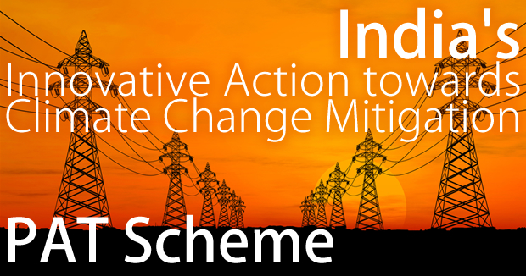
Market-based Mechanism
Perform, Achieve and Trade (PAT), Bureau of Energy Efficiency
Launched in April 2011
A market based mechanism to enhance cost effectiveness of improvements in energy efficiency in energy intensive large industries and facilities, through certification on energy savings that could be traded
Targets for improvements in energy efficiency are set under section 14 of the Energy Conservation Act,
The Government, in March 2007 notified units in nine industrial sectors, namely aluminium, cement, chlor-alkali, fertilizers, iron and steel pulp and paper, railways, textiles and thermal power plants, as Designated Consumers(DCs)
Source: http://beeindia.in/schemes/schemes.php?id=9
Notes:
Riddhi Siddhi Gluco Biols Ltd. (RSGBL) is a manufacturer of high quality starch, glucose and their
derivatives. RSGBL produces Maize starch powder and its derivatives such as Liquid glucose, Dextrose
Monohydrate, Maltodextrine, Dextrose syrup, High maltose corn syrup and the by products like Maize
Germ, Corn Gluten meal, Corn Steep Liquor, Enriched Fibre, Cattle feed and Hydrol which are used in
various applications catering to food, textile, paper, pharmaceutical and confectionary industries. The
industry crushes about 750 tones of corn per day.
The maize/ corn is the basic raw material of the industry. The cleaned corn is steeped in sulphurous acid
water for about 50 hours. Light steep water is generated while steeping which is concentrated up to 50 %
to get corn steep concentrate also known as Corn Steep Liquor (CSL). The steeped corn is passed
through degerminating mills to separate out Germs. The remaining material is again passed through
various grinding and separation stages to separate out gluten from starch. Gluten slurry is thickened by
centrifugation and vacuum filtration before drying. The starch slurry further processed in hydrocyclones
to remove trace amount of impurities. This slurry is called wet starch from which, the final products of
Starches, Liquid glucose, Dextrose monohydrate and Maltodextrines are produced.
Considerable quantity of wastewater is generated from steeping, dewatering and refining processes and
this wastewater is rich in organics. This organic rich wastewater was treated through open anaerobic
lagoons to reduce its organic concentrations before discharge to meet the environmental norms. Methane,
a potent Green House Gas (GHG), rich biogas was formed and emitted to the atmosphere. Realizing the
global warming effects of the biogas on the environment, the project proponents proposed to substitute
these anaerobic lagoons with closed anaerobic reactors to recover methane rich biogas and to utilize this
biogas to generate electricity. Installation of closed anaerobic digesters to recover methane rich biogas
and utilize the biogas to generate electricity is the small scale project activity.

Slide 20
Adaptation

Slide 21
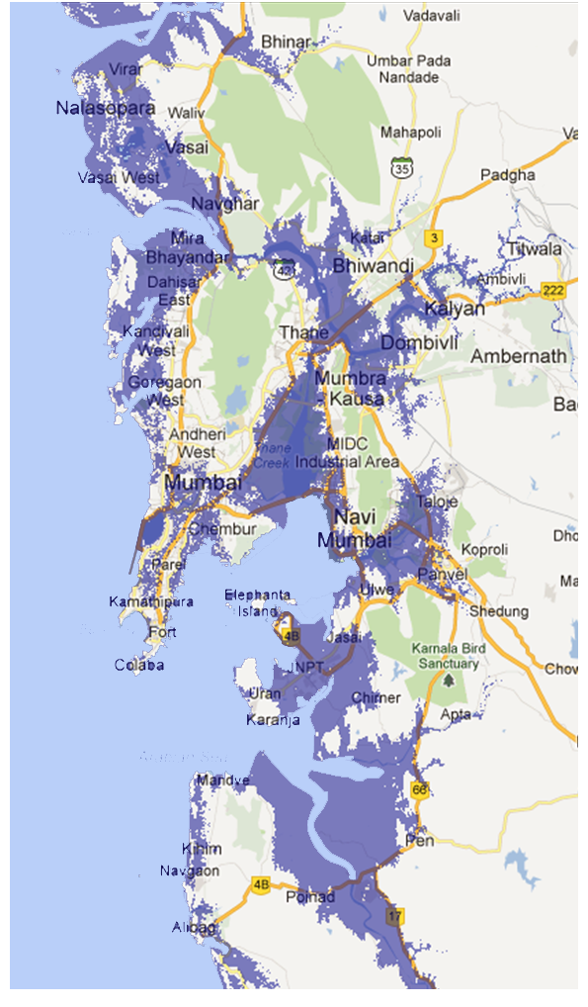
Industrial areas in Low elevation coastal zone
Industries of South Mumbai, Chembur, Navi Mumbai, Thane, Khopoli and Alibaug fall under LECZ.
Together they cover all major industrial areas
Adaptation measures to be taken
• Rising dykes all along the vulnerable areas
• Abandoning of low lying areas
• Shifting all activities to highlands
• Building sea wall and rising structures on stilts
• Land use planning policy (E.g. Disallowing development in LECZ)
• Create a buffer areas from sea
• Cost benefit analysis of protection options, study and model possible features.
• Create a condition for possible retreat
• Redistribute local economy
Industrial area
LECZ
Source: Adapted from: Raja S, Parthasarathy R, (2010)A Paradox in Environment and Economic Development in the context of probable impacts due to Sea Level in Low Elevation Coastal Zones: The Case of Surat City
Note: Industrial zones
(approx. area) overlaid on 10m elevation zones (LECZ)
Notes:
Not many studies have been done on adaptation by industries in low elevation coastal zones, but a study for Hazira has been shown above.
As we can see almost all major industrial zones are vulnerable.
The measures shown are to be taken by authorities but can be collectively done by the industries also.

Slide 22
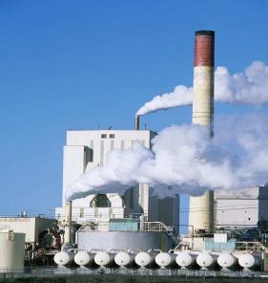
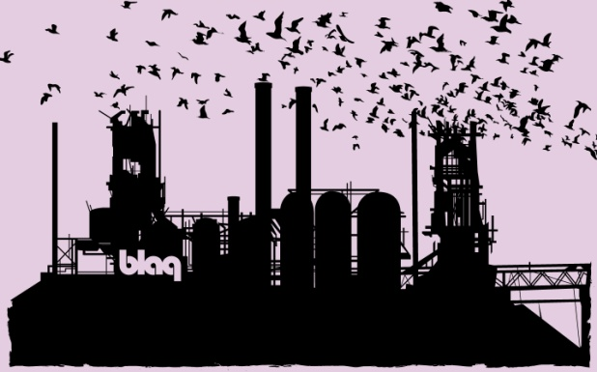
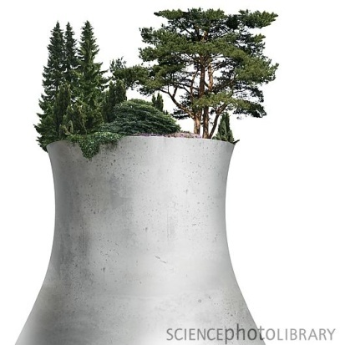
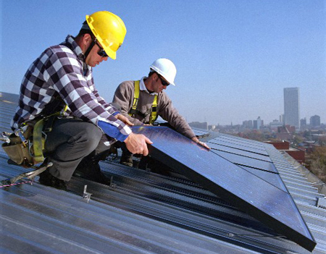
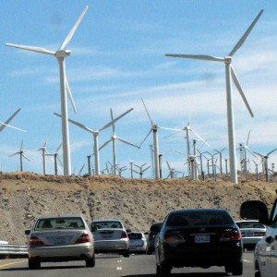
Conclusion
Climate change is happening and the time to act is NOW!
Industries, hold a large share in the economic growth of MMR. It has a significant contribution in generation of employment in the region. However, most of the industrial locations lie within Low Elevation Coastal Zone increasing the risk due to coastal inundation & sea level rise.
Industries like Petrochemicals, chemicals, metal products, textiles etc. consume high amount of energy and are largest emitters, thus they have to change their ways of working to achieve sustainability. Investments in made now will translate in to Long term financial benefits
For sustainable industrial growth
Emissions & resource utilization has to be lowered
Processes & energy sources have to be changed
Technology has to be revolutionised

Slide 23
The presentation is part of the series Climate Change related Resources and Tools (CCRT) developed to spread awareness on climate change and related issues as well as to facilitate actions to lessen the impact of climate change. As part of the series various other booklets, posters, factsheets, presentations, etc. have been created. The portal also has online carbon footprint calculators and a map on climate change related institutions.
To know about the other resources created under this series visit www.mmr-ccrt.org.in.
Conceived and Developed by :
Environmental Management Centre LLP for Mumbai Metropolitan Region – Environment Improvement Society

Slide 24
http://www.financewalk.com/2011/industry-analysis/
http://paul-bikes.deviantart.com/art/Industry-Wallpaper-75426537
http://www.sciencephoto.com/media/392531/enlarge
http://hooplanow.com/tag/university-of-northern-iowa/

Slide 25
http://www.regionalplan-mmrda.org/N-4.pdf
http://www.cidcoindia.com/UserFiles/File/Industries-Summary.pdf
http://mayaanjali.hubpages.com/hub/Dharavi-A-slum-beyond-comparison
http://mpcb.gov.in/ereports/ereports.php
http://www.ipcc.ch/pdf/technical-papers/paper-I-en.pdf

