Slide 1
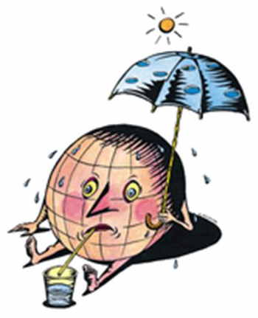
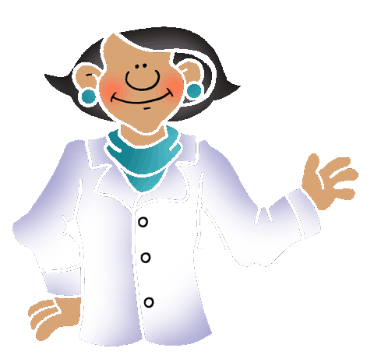
Source: www.blewbury.co.uk

Slide 2
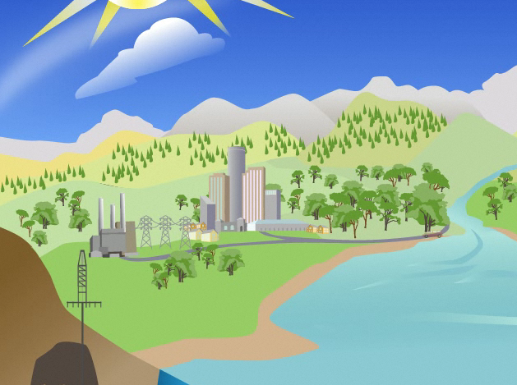
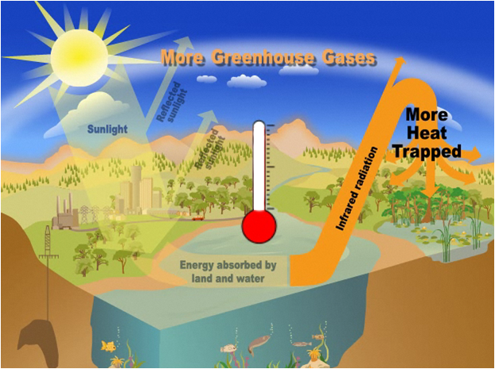
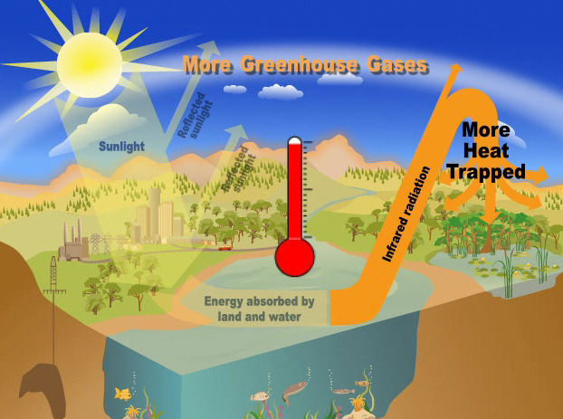
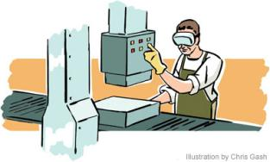
What is Global Warming?
What are greenhouse gases?
Gases that contribute to the greenhouse effect by absorbing infrared radiation, e.g. carbon dioxide, Methane, Nitrous oxide
Earth requires greenhouse gases so that living beings can survive
We add more greenhouse gases every day
When we use electricity
How are they generated?
BUT
Temperature
Increases
Leading to
When we drive our cars
When we Make a product in a factory
Global warming
Source: http://www.epa.gov/climatechange/kids/basics/today/greenhouse-effect.html
Notes:
The atmosphere has a natural supply of "greenhouse gases." They capture heat and keep the surface of the Earth warm enough for us to live on. Without the greenhouse effect, the planet would be an uninhabitable, frozen wasteland.
Before the Industrial Revolution, the amount of carbon dioxide (CO₂) and other greenhouse gases released into the atmosphere was in a rough balance with what was absorbed in natural sinks. For example, plants take in CO₂ when they grow in spring and summer, and release it back to the atmosphere when they decay and die in fall and winter.
Industry took off in the mid-1700s, and people started emitting large amounts of greenhouse gases. Fossil fuels were burned more and more to run our cars, trucks, factories, planes and power plants, adding to the natural supply of greenhouse gases. The gases—which can stay in the atmosphere for centuries—are building up in the Earth’s atmosphere and, in effect, creating an extra-thick heat blanket around the Earth.
The result is that the globe has heated up by about one degree Fahrenheit over the past century—and it has heated up more intensely over the past two decades.
Today, people have increased by nearly 40 percent the amount of CO₂, the chief global warming pollutant, compared to pre-industrial levels

Slide 3
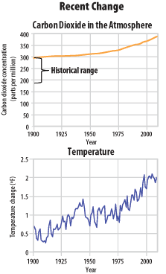
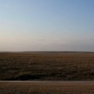
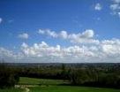
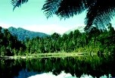
Earth’s Climate
The Earth was formed about 4.5 billion years ago
The Earth’s climate clues are hidden in rocks, trees, fossils and corals
They tell us that Earths climate has changed many times in the past
The reasons were : changes in Sun’s energy, photosynthesis, volcanic eruptions etc.
Climate change today: Scientists agree that it is because of human activities
Notes:
Here some information on climate science is given.
It tells us that we know that the climate change in the past. That change was due to sun’s energy, volcanoes etc. but we can also see that the increase in carbon dioxide in atmosphere after industrial revolution has led to increase in temperature which would not have been possible in normal conditions.
After many years of research the scientists have concluded that climate change is happening and that it is happening because of us.

Slide 4
Impacts of Global Warming
Extinction and loss of biodiversity
Spread of diseases
Change in Seasons
Droughts and wild fires in some places
Increased evaporation
Global warming
Melting of glaciers,
snow caps
Increased Rains in some places
Coastal area loss
Warmer Oceans
Increased storms
Sea Level Rise
Adapted from: http://epa.gov/climatechange/kids/basics/concepts.html
Notes:
Rising global temperatures lead to other changes , such as stronger hurricanes, melting glaciers, and the loss of wildlife habitats. That's because the Earth's air, water, and land are all related to one another and to the climate. This means a change in one place can lead to other changes somewhere else. For example, when air temperatures rise, the oceans absorb more heat from the atmosphere and become warmer. Warmer oceans, in turn, can cause stronger storms.
Since the 1970s, droughts have become longer and more extreme worldwide, particularly in the tropics and subtropics.
As temperatures rise and the air becomes warmer, more moisture evaporates from land and water into the atmosphere. More moisture in the air generally means we can expect more rain and snow (called precipitation) and more heavy downpours. But this extra precipitation is not spread evenly around the globe, and some places might actually get less precipitation than they used to get. That's because climate change causes shifts in air and ocean currents, which can change weather patterns
Hurricanes and other tropical storms get their energy from warm ocean water. As the top layer of the ocean gets warmer, hurricanes and other tropical storms grow stronger, with faster winds and heavier rain. Because of higher temperatures and increased evaporation, climate change causes other types of storms to get stronger, too.
As water gets warmer, it takes up more space. Each drop of water only expands by a little bit, but when you multiply this expansion over the entire depth of the ocean, it all adds up and causes sea level to rise. Sea level is also rising because melting glaciers and ice sheets are adding more water to the oceans.

Slide 5
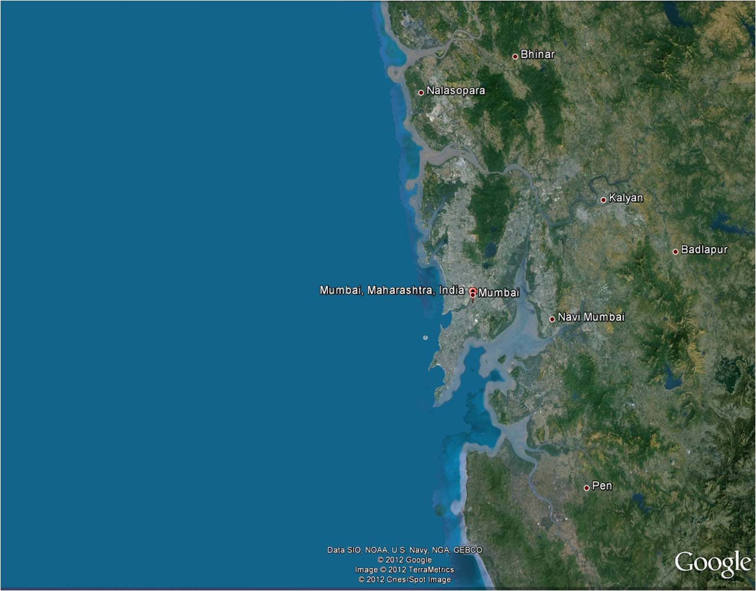
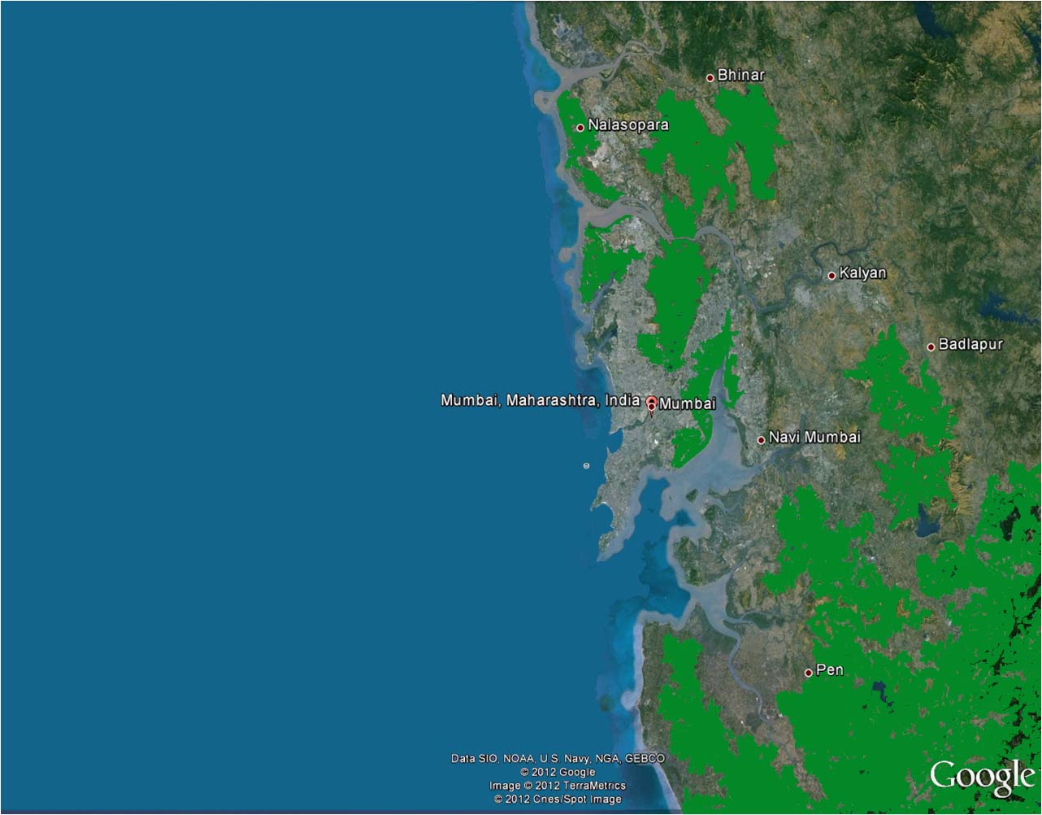
How will it affect us?
Long coastline – So more areas can be affected by storms, sea level rise and submergence
Many low lying areas can be affected by flooding of rivers and flash flooding due to extreme rainfall.
Water logging – increase in spread of diseases like malaria, dengue etc.
Less rainfall can affect agriculture and forests which provide us with food and timber.
Less rainfall also means less water for drinking, washing and bathing
Change in forests can affect birds and animals living in the forests
Notes:
This slide informs the students about how the impacts shown on the previous slide will affect the MMR and its surroundings.
This slide informs the citizens about how the impacts shown on the previous slide will affect the MMR and its surroundings.
As MMR has a long coastline with regions lower than the mean sea level. Thus with cyclones and stormy conditions these areas will be affected.
Also sea level rise, will cause the sea water to penetrate the ground water and make the foundations of building and infrastructure weak.
This region also receives huge amount of rainfall leading to water logging in low lying areas and flooding. Water logged areas are vulnerable to diseases like malaria and dengue. Also water borne diseases like cholera and jaundice can affect the communities.
As the climate will become uncertain, there are chances of the region receiving less rainfall than average. With such a huge population, the scarcity of water will affect the day to day lives of the citizens. Also agricultural production will decrease, leading to food security.
Extreme rainfall or drought like situations can affect all forms of life including plants, animals and birds. The food chain gets disturbed and as human beings are part of the food chain we will get affected too.

Slide 6
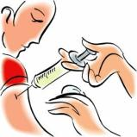
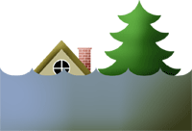
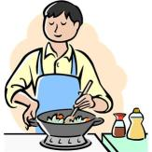
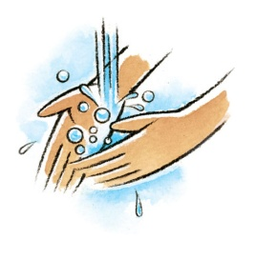
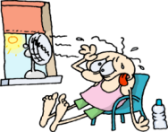
To Avoid-Take Action
HEALTH
Vaccinate yourself and spread awareness to your neighbors
Keep your surroundings clean
Do not let water log in your surroundings
Avoid eating outside, eat home made nutritious food
Wash your hands/ use sanitizer before eating
Drink plenty of water during summers
Do not move out at noon if heat waves are predicted
Notes:
This section is to informs the children that there will be an increase in the vector borne and water borne diseases,
And thus, it is advisable that they follow the above mentioned action to keep healthy.

Slide 7
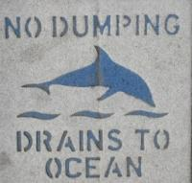
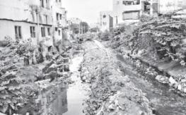
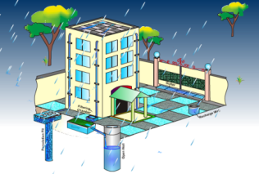
To Avoid-Take Action
FLOODING
Do not throw garbage in storm water drains
Do not block natural water run-off
DROUGHTS & WATER SCARCITY
Do not waste water, use it economically
Harvest rain water at your home/ society
Notes:
Children should know that MMR is prone to flooding and that what are the simple steps that can avoid flooding.
Similarly fresh water is a scare resource and they should know how they can conserve it.

Slide 8
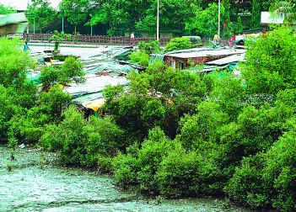
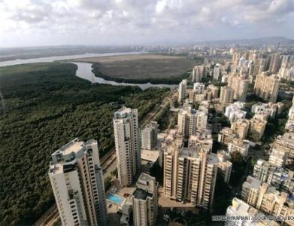
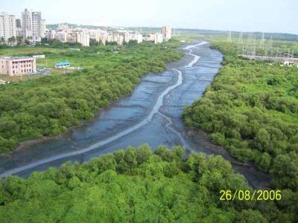
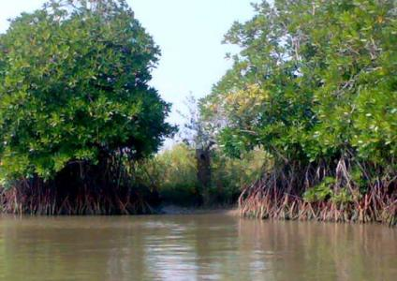
To Avoid-Take Action
FORESTS AND WILDLIFE
Do not cut trees in your neighborhood, preserve them
Plant more trees. They help to absorb water, give shade and purify the air
Protect the mangrove forests
As
They reduce the flood impact
They reduce effects of storms and tsunamis
They are home to many different birds, animals and fishes
Notes:
This slide gives information on forest and their importance.
Also a special focus is on mangrove preservation as they are of great importance to the coastal areas.

Slide 9
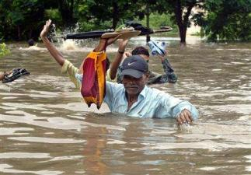
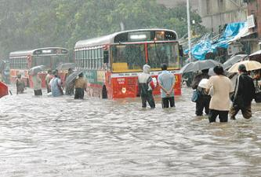
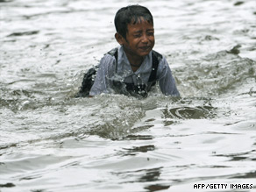
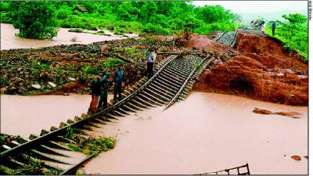
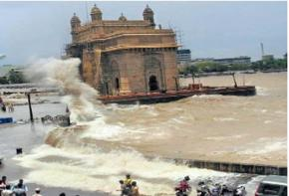
In emergencies
Like FLOOD and STORMS
Listen to warnings, follow the given instructions and paths
Think of safety first during a flood
Turn off electricity and gas supply when evacuating
Take care when walking through water logged areas
Avoid contact with floodwater as it may be contaminated
Don’t try to walk or drive through floodwater.
Take refuge under strong buildings and structures
Notes:
Children may have to face flooding and storms when they are at schools and colleges.
Here some emergency advisory steps are given for them if they find themselves alone in any situation.

Slide 10
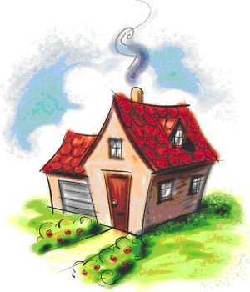
What can we do to reduce GHG emissions?
@HOME
Home cooling
Appliances
Water
Lighting
@HOME
TRANSPORT
FOOD
CONSUMPTION AND WASTE
Notes:
This slide and the slides below give the children an idea on how to reduce the ghg emissions.
Here emphasis is on small things which collectively can make a big difference.
The major point to highlight is that every one can help to reduce ghg and that they should share this information with their parents and neighbors.

Slide 11
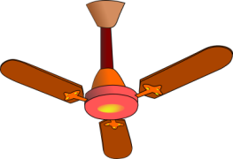
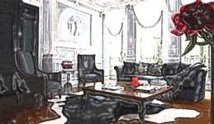
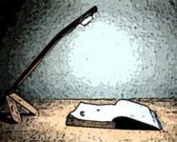
@ Home
Home cooling
Use fans instead of ACs
Use energy efficient fans and cooling devices/system
Unplug devices when not in use
Lighting
Switch off the lights & fans when not in use
Replace Incandescent lamps with LEDs or CFL lamps
Use natural light during day time
Use focus lights instead of lighting the whole room

Slide 12
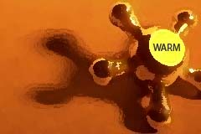
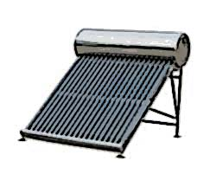
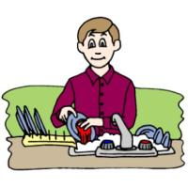
@Home
Water
Use bucket instead of shower
Use warm water instead of hot water
Check for leaks
Turn off tap when not in use (brushing teeth's, washing etc)
Use solar water heater
Do not wash utensils under running water

Slide 13
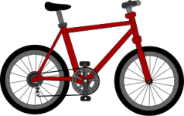
What can we do to reduce GHG emissions?
TRANSPORT
Kilometers Traveled
Vehicle maintenance
Efficient driving
Mode of Travel
@HOME
TRANSPORT
FOOD
CONSUMPTION AND WASTE

Slide 14
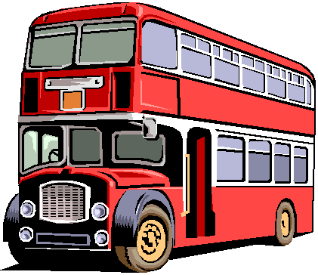
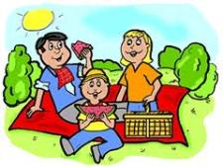
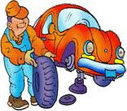
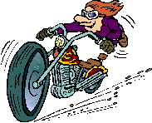
Transport
Kilometers traveled
Use public transport
Car-pool, walk or cycle to schools and colleges
Go on holidays closer to home
Vehicle maintenance
Check tire pressure regularly
Get vehicle serviced regularly
Fuel efficient driving
×
Maintain steady speed
Accelerate and brake steadily

Slide 15
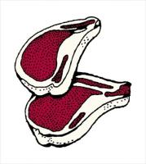
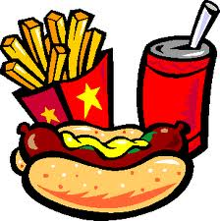
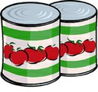
What can we do to reduce GHG emissions?
FOOD
Food kilometers
Locally grown food items
Efficient cooking
Processed food and meat
@HOME
TRANSPORT
FOOD
CONSUMPTION AND WASTE

Slide 16
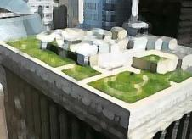
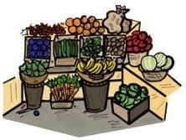
FOOD
Food Kilometers
Buy locally grown food
Avoid Food products from foreign countries
Locally
Grown food items
Use balconies and terraces to grow your own food
Buy fewer processed food items
Efficient Cooking
Buy organic food items grown locally
Use pressure cookers or cover pans while cooking

Slide 17
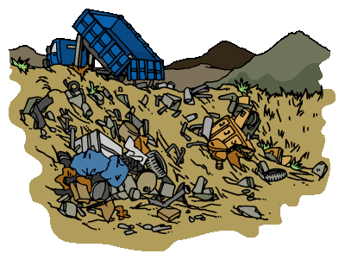
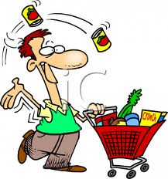
What can we do to reduce GHG emissions?
CONSUMPTION AND WASTE
Reduce
Reuse
Recycle
Compost
@HOME
TRANSPORT
FOOD
CONSUMPTION AND WASTE

Slide 18
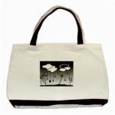
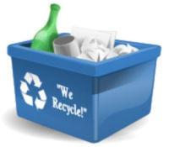
Consumption and Waste
×
Reduce
Reuse
Recycle
Buy only what you need
Repair broken items and reuse
Use cloth bags for shopping
×
Avoid using disposable and packaged items
×
Reduce paper use, print only if needed
Recycle paper, plastic, aluminum cans, glass, electronics, light bulbs
Donate unwanted cloths, stationary, books & artifacts
Separate dry waste and wet waste
Use wet waste to prepare compost, Compost can be used for gardening and
growing food at home

Slide 19
Activities
In Schools
In your house
In your neighborhood
In your city

Slide 20
Activities
TREE CLUB
Learn about the trees that can be planted in your campus
Plant trees in your campus and near your home
Take turns to water them
Spread awareness regarding benefits of trees
Raise your voice to protect the trees and forests
WATER CLUB
Learn about different water resources
Find out why we need to conserve water
Find means to conserve water
Spread awareness amongst your friends, families and neighbors regarding WATER
Notes:
These activities can be explained to them by giving examples of other clubs that are working in the school or college.
While presenting tell the children to give each club an unique name to the club so as to involve them.

Slide 21
Activities
BOOK AND FILM CLUB
Search for books and films on climate science, environment, water, biodiversity, etc.
Form a club with the help of your librarian
Take up new topics every week and discuss them
Have quiz and interactive presentations
Learn more, broaden your vision
SUPERHERO CLUB
Find out the possible impacts due to Climate Change on your surroundings.
Search for a safe place: Like higher grounds, strong buildings
Conduct Safety Drills: Make evacuation plans by involving everyone
Save lives and become a superhero

Slide 22
Activities
STUDY TRIP CLUB
Search for, nature parks, beaches, mangrove forests, lakes, composting sites, bio-gas plants, recycling plant etc.
Organize painting, writing and debate competitions to create awareness.
Find experts to take you on nature trails
Understand the importance of the visit
Protect it, conserve it, let it flourish
INVOLVEMENT OUTSIDE CAMPUS
Register with youth networks and programmes
E.g. Tata Energy club, Greenpeace, IYCN(Indian Youth Climate Network), and many other NGOs
Participate in their activities and help combat climate change

Slide 23
And Finally to Conclude…
Climate change will affect our daily lives
Precautions in terms of health, food and water are important
By using public transport, decreasing the consumption and waste, emissions can be reduced
By taking measures like rain water harvesting and keeping the drains clean, disasters can be evaded
Adopt traditional knowledge systems which are sustainable

Slide 24
And Finally to Conclude…
One drop makes an ocean
Each one of you can make a difference
It is the biggest exam of our lives… Lets get a pass grade at least
What kind of world do you want to live in?
OR

